Slide 1
Student Appointment Chat bot
Team members :
Haritha Thumukuntla Sandeep reddy Chevula Chenna Srinivas Mamjala Manisha

Slide 2
INTRODUCTION:
Chatbot is one of the fast and effective methods of communication on many websites. Where the chatbot will converse with consumers and respond to all incoming inquiries.
we are developing a Chatbot application for the University of Missouri Kansas City to verify the possibility of booking an appointment with an academic advisor.

Slide 3
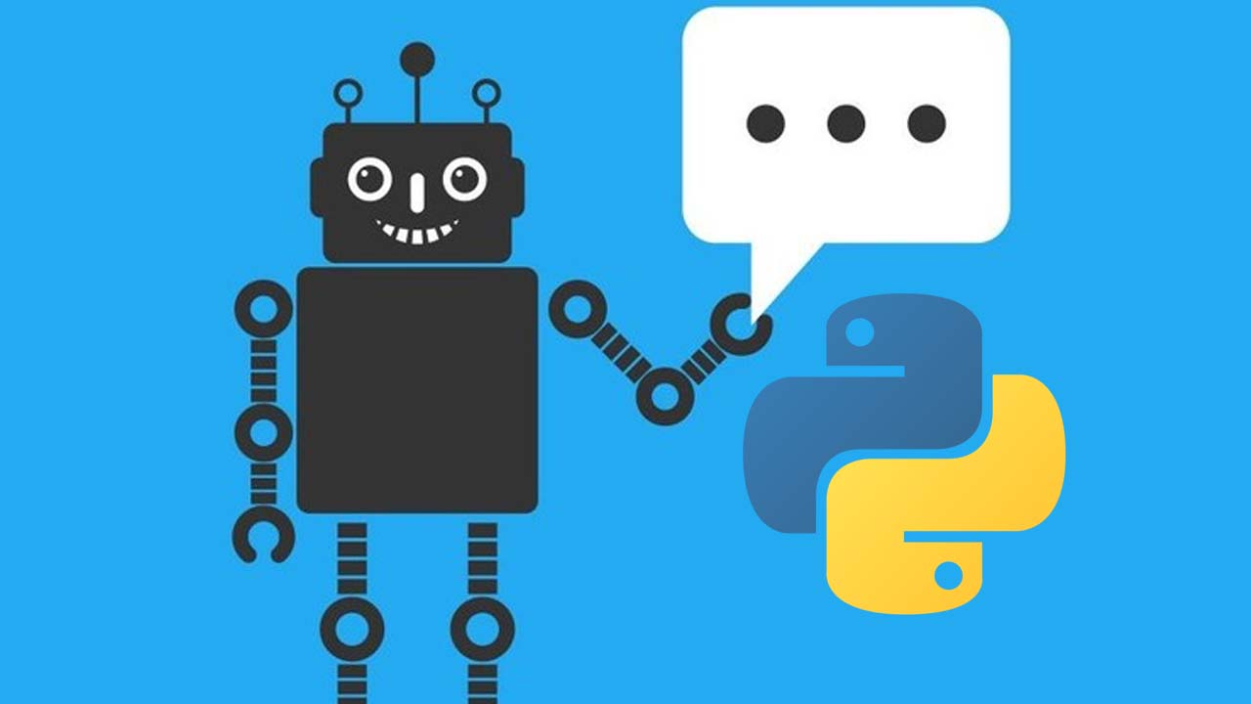
Chatbots can be problem-solution bots or domain-precise bots mostly they are knowledge based. These can act as Virtual aides for Problem solving

Slide 4
PROPOSED WORK
The main purpose of the chatbot is to respond to student queries with out manpower.
The chatbot receives the query, which is an input by the student, analyses it and in turn responds to the user with an answer.

Slide 5
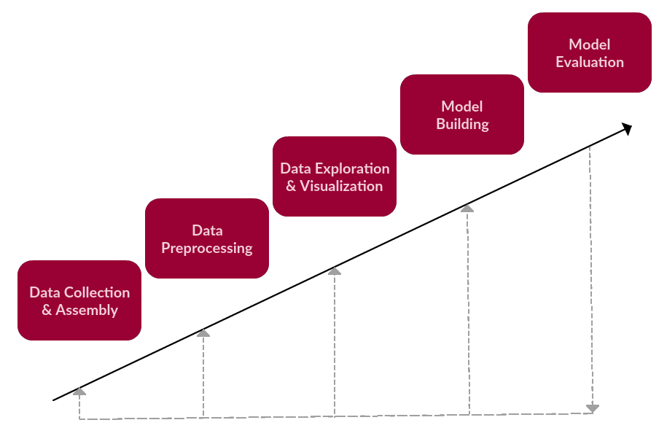
Implementation and Evaluation
Pre-processing using NLP
Splitting the data into train and test
Extracting the features on the train and test data
Selecting the algorithm
Naïve Bayes and Multinomial NB
Fitting the train data set with model

Slide 6
Flow of the system
Training Questions
Hi I can help you book a slot for recreational activities? 1
Corresponding Answers
1. Which time slot do you want to book and which activity?
Train
on vectors
Corresponding labels
In this case it is 1
Naïve Bayes Classifier
Word to be predicted
(in a vector form)
Recreational Activities

Slide 7
Working Algorithm
Step 1) Select a data set, for which we need to develop a chatbot.
Step 2) Prepare the set of entities with the patterns and the responses.
Step 3) Install the required packages in python
Step 4) Train the chatbot on the dataset to understand the intent of the user
Step 5) Develop the GUI and integrating it with the bot
Step 6) Execute the codes for the results

Slide 8
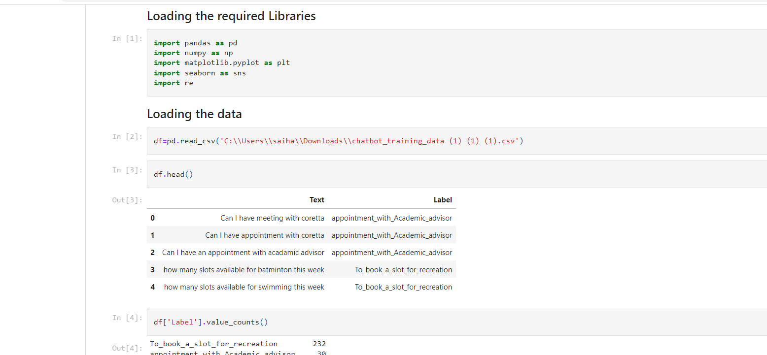
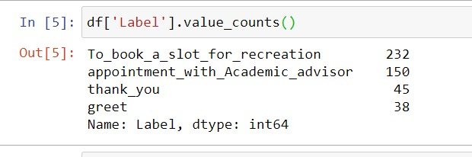
Pre-processing using NLP: The analysis and pre processing of the text is performed using NLP is to clean the text and use it for the further research of the model.

Slide 9
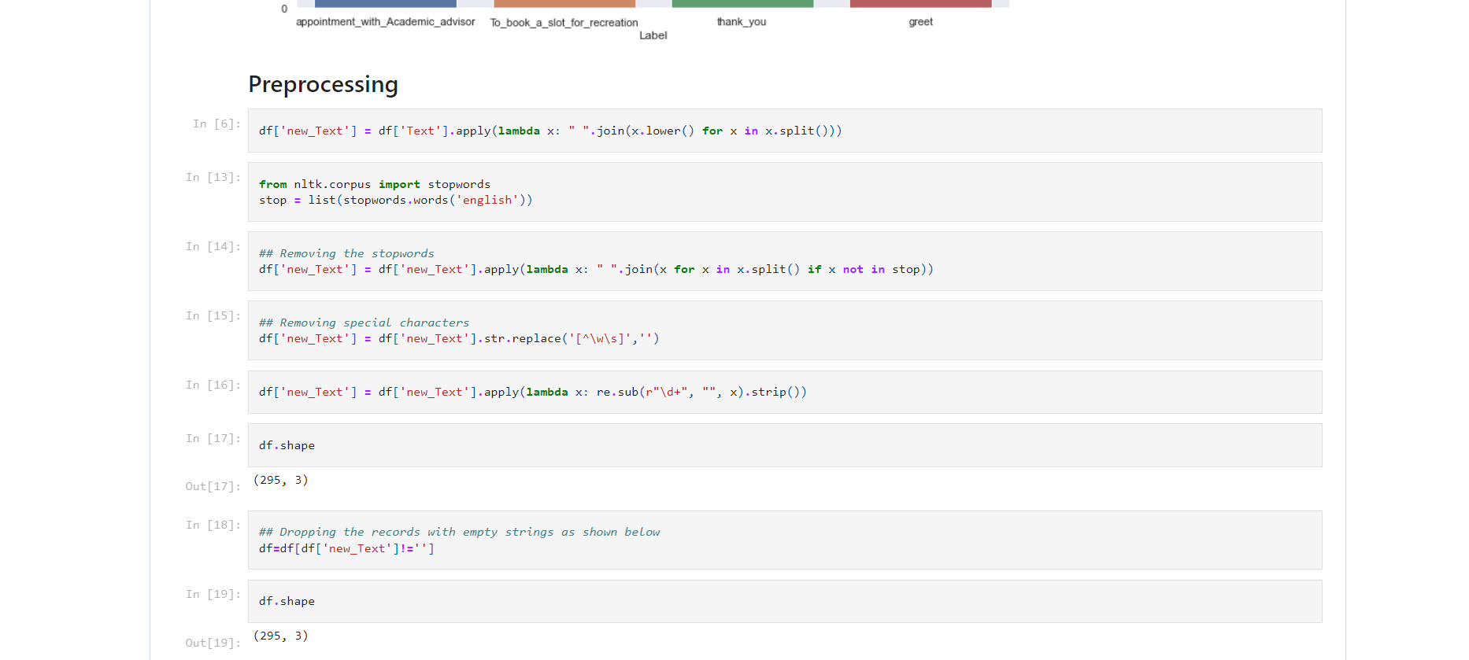
Pre-Processing the Text

Slide 10
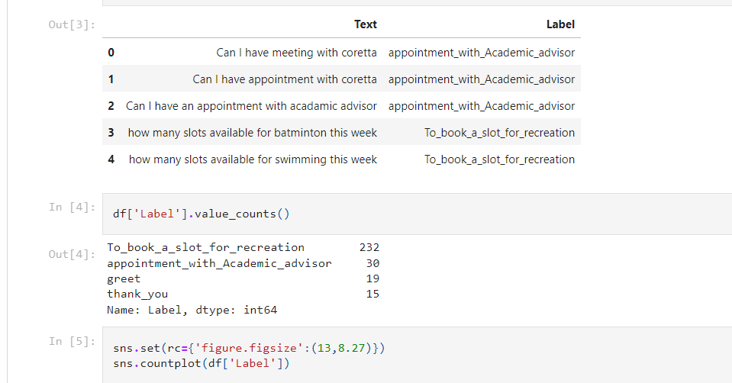
Dataset:
The classes required for building the model are prepared in a file, along with a list containing question, labels and answers with the code below:

Slide 11
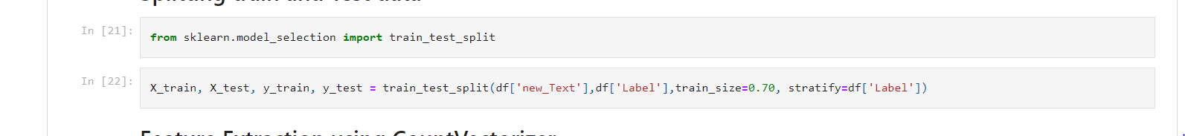
Splitting training and Test data:
The training and testing ratio which we have taken in this project is 70:30 ratio.

Slide 12
Feature Extraction using CountVectorizer
We have converted our training questions to vectors in order to feed them in to the classifier.
The .fit_transform() method of CountVectorizer() does two things:
1) trains the features dictionary
2) Transforms each question into vectors of a size of features dictionary that contains zeros in all places except for the words used in the question

Slide 13
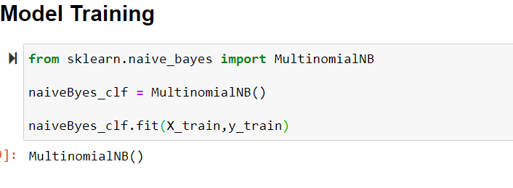
Multinomial Naive Bayes:
After creating the training vectors we created a Naive Bayes Classifier.
We have used MultinomialNB() to train our classifier using .fit() method.
This trains the classifier to make the predictions by taking an input from the user , convert it into vector with the help of vectorizer and get predictions of the label

Slide 14
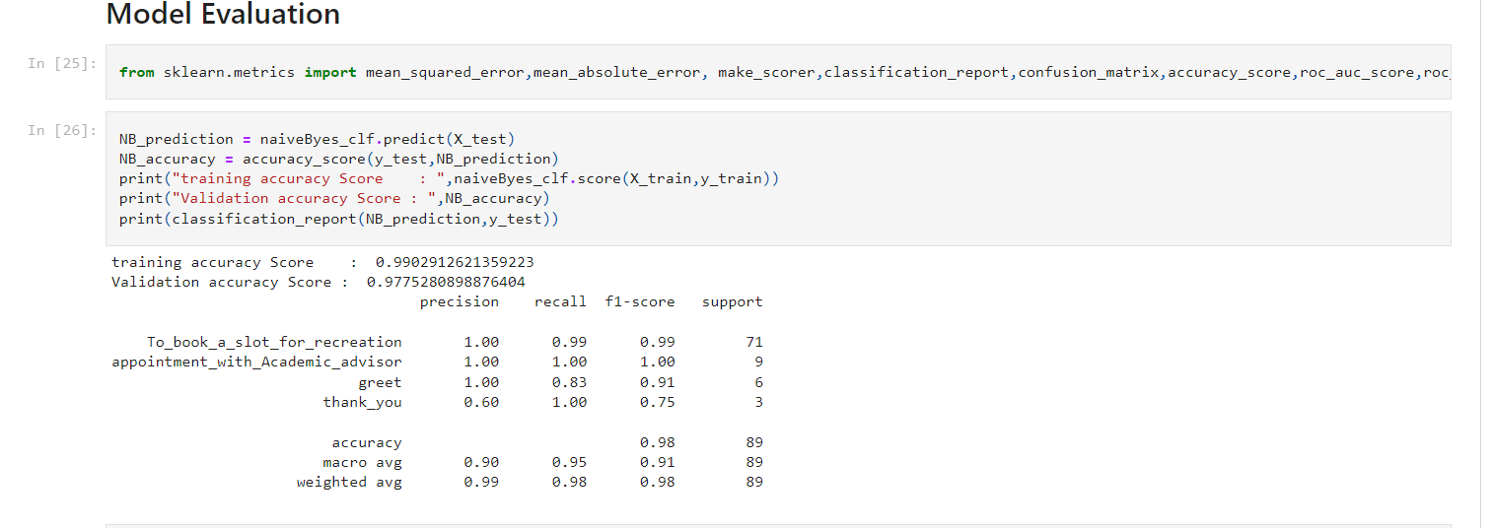
MODEL EVALUATION:
The model evaluation is performed to check the accuracy of the trained model on the test dataset.

Slide 15
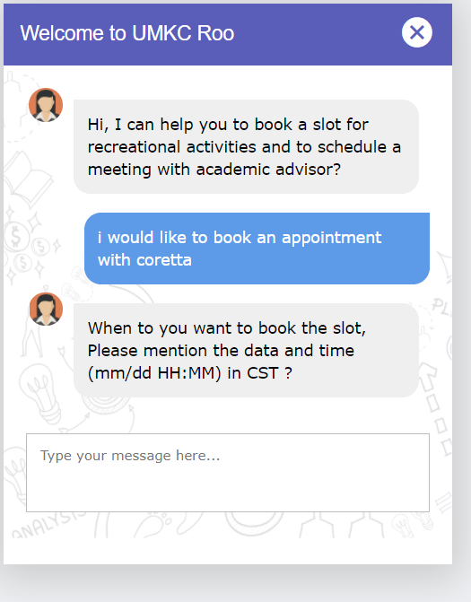
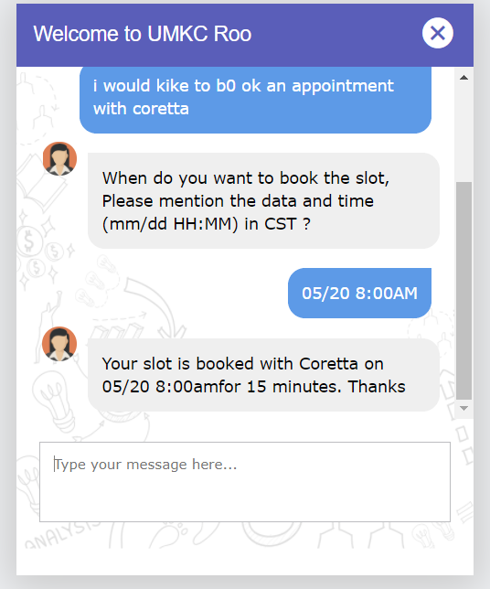
OUTPUT:

Slide 16
contributions
Chenna Srinivas
Haritha Thumukuntla
Sandeep reddy Chevula
Manisha Mamjala
Created the input data for 2 classes
Database connections
Designing the project
Loading the data
Preprocessing the data
Created the UI
Programmed the flow
Build the model
Created the input data for 2 classes
Created the script to log the conversations of chatbot

Slide 17
